Slide 1

Research Question – Tutorial Presentation for Feedback Date:
Group Name: A177 Name of Student Presenting: Roshwin Johny

Slide 2
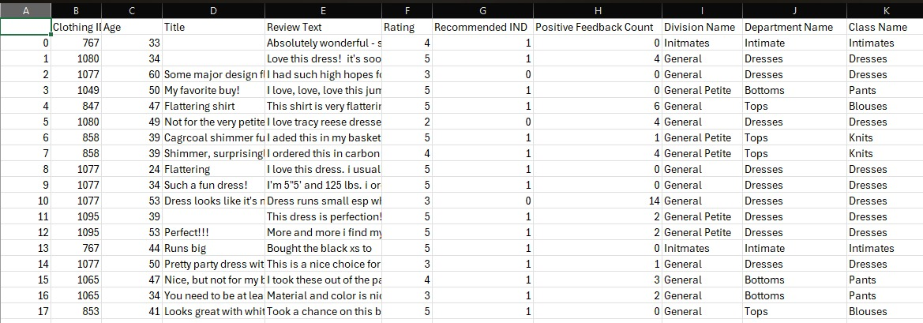
DATASET - Womens Clothing E-Commerce Reviews.csv
Our dataset has 23486 Rows

Slide 3
This dataset is interesting to us because : This dataset is interesting because as a teenager and being a part of a significant consumer demographic, analysing this data helps us to understand how our generations opinion differ from older ones. Our Independent variable is: DEPARTMENT NAME This Independent variable datatype is : Nominal. Our Dependent variable is: RECOMMENDED INDEX This Dependent variable datatype is : Nominal
Dataset ID - DS 147 Women's E-Commerce Clothing Reviews (kaggle.com)
Notes:
Before specifying your Research Question you must define the type of data you are analysing. Are the variables you select interval data (measurement data you can divide, multiple, etc), OR are they ordinal (there is a definite order but the intervals between each variable are not necessarily equal, or the terms might be subjective like in a likert scale); OR are they just categorical/nominal (Items such as film names, cities, etc., that you can count numbers of occurrences? You also need to understand whether the variable is either dependent or independent and this will vary according to the context. Independent variables may cause an effect, whereas the dependent variable might be effected by the independent variable. Check the lecture notes on the RQ for more information and examples.
You will get only one opportunity to present your Research Question ahead of the submission date. Have your questions ready, and be ready to take notes on feedback.

Slide 4
“ Is there a difference in the proportions of recommendations and non – recommendation in reviews of clothes tops and clothes bottoms sold by a company “
Our Research Question is

Slide 5
–
Null hypothesis (H₀):
There is no difference in the proportions of recommendations and non-recommendations between reviews of clothes tops and clothes bottoms.
Alternative Hypothesis (H₁):
2. There is a difference in the proportions of recommendations and non-recommendations between reviews of clothes tops and clothes bottoms.

